Slide 1
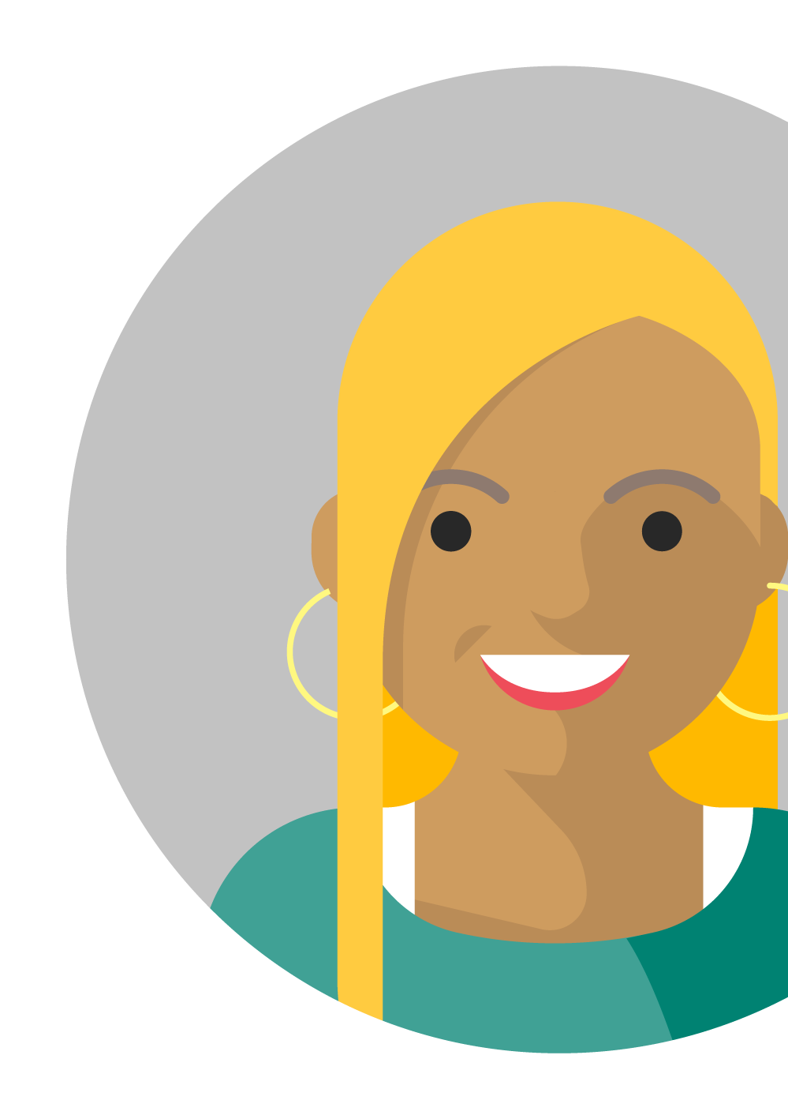
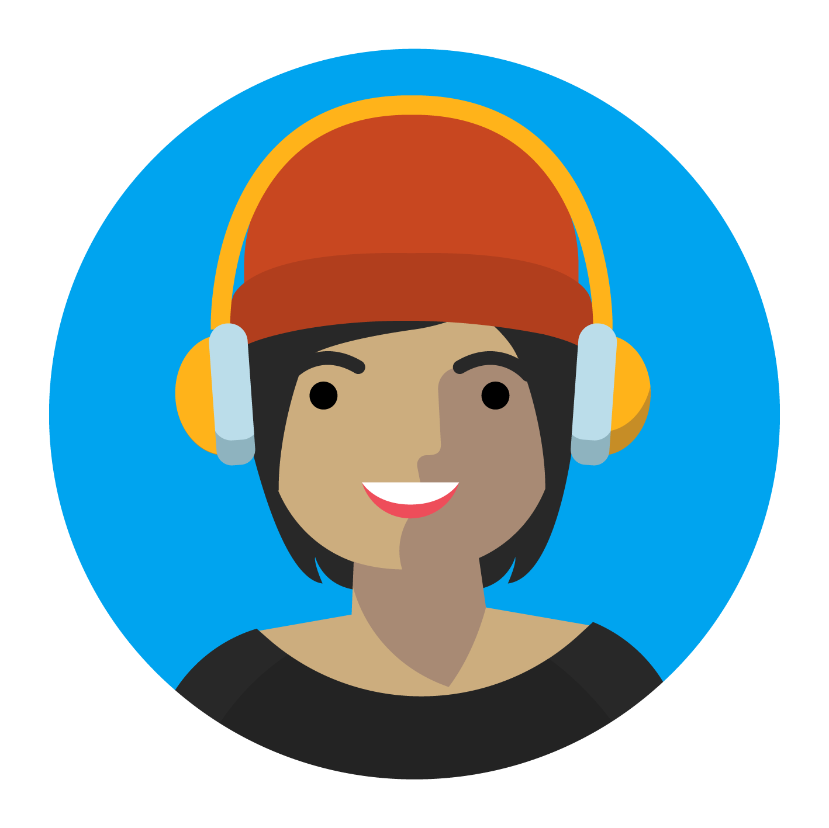

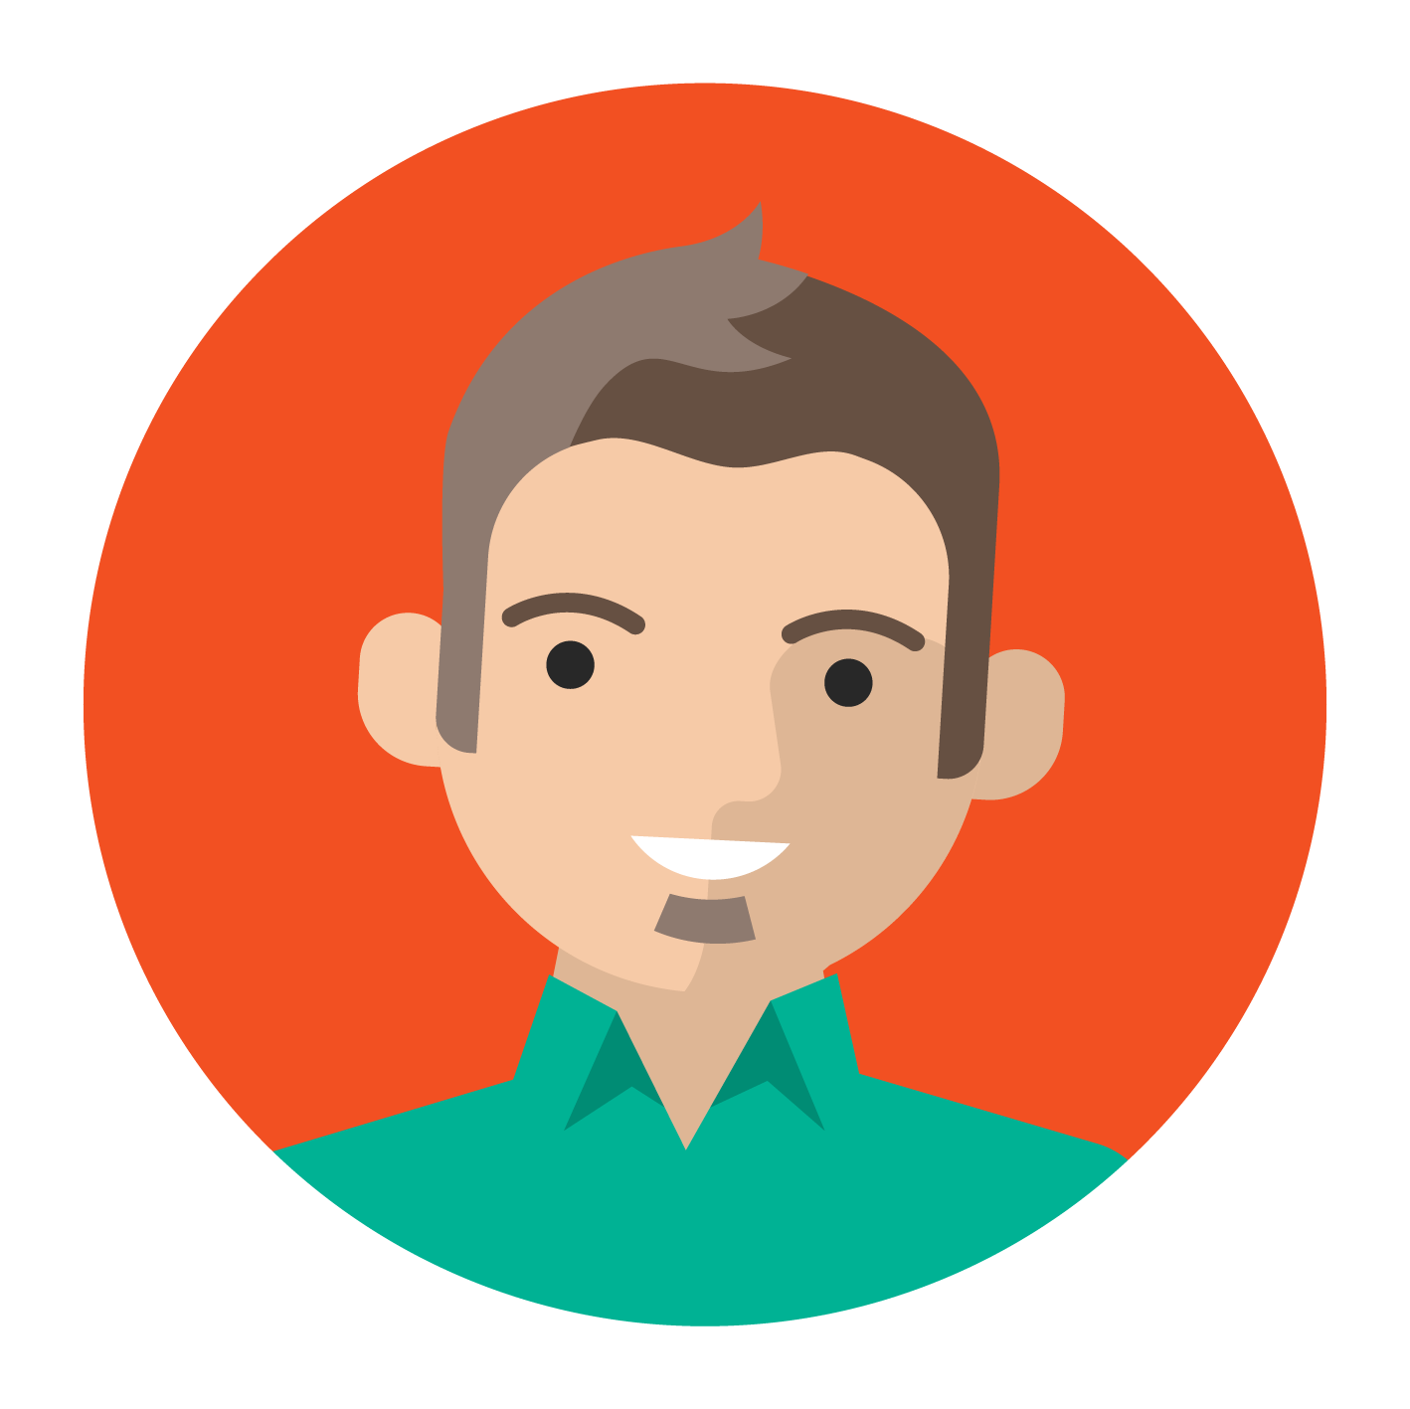


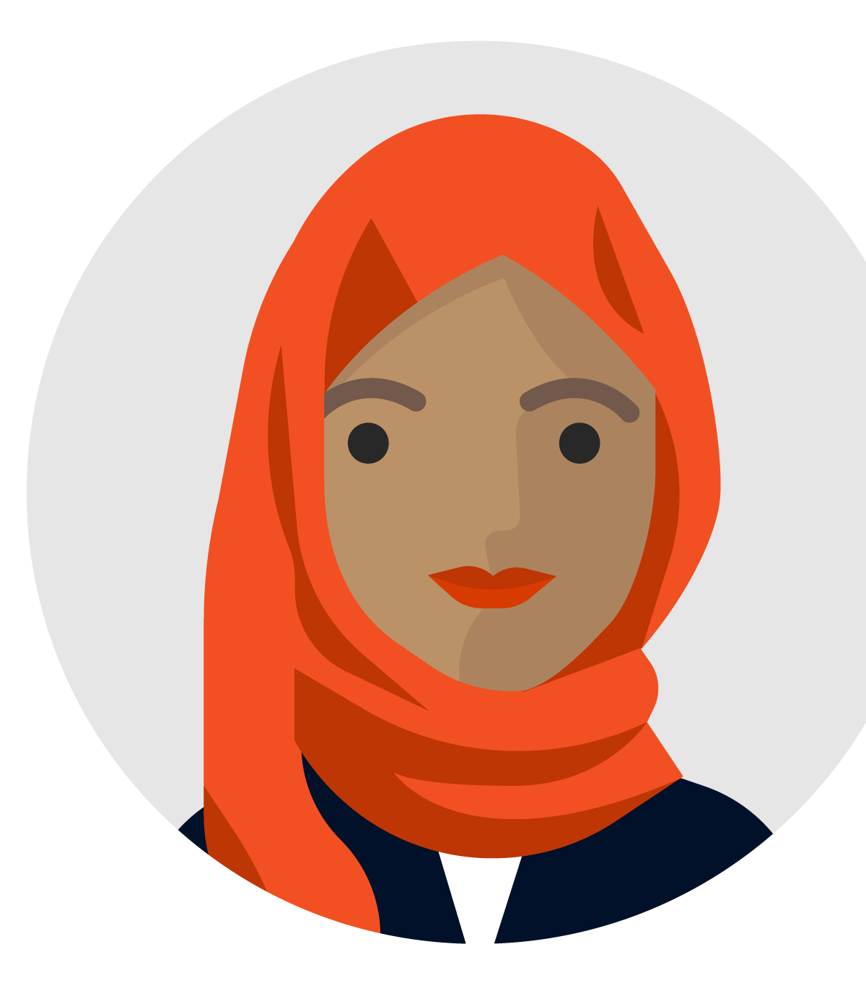
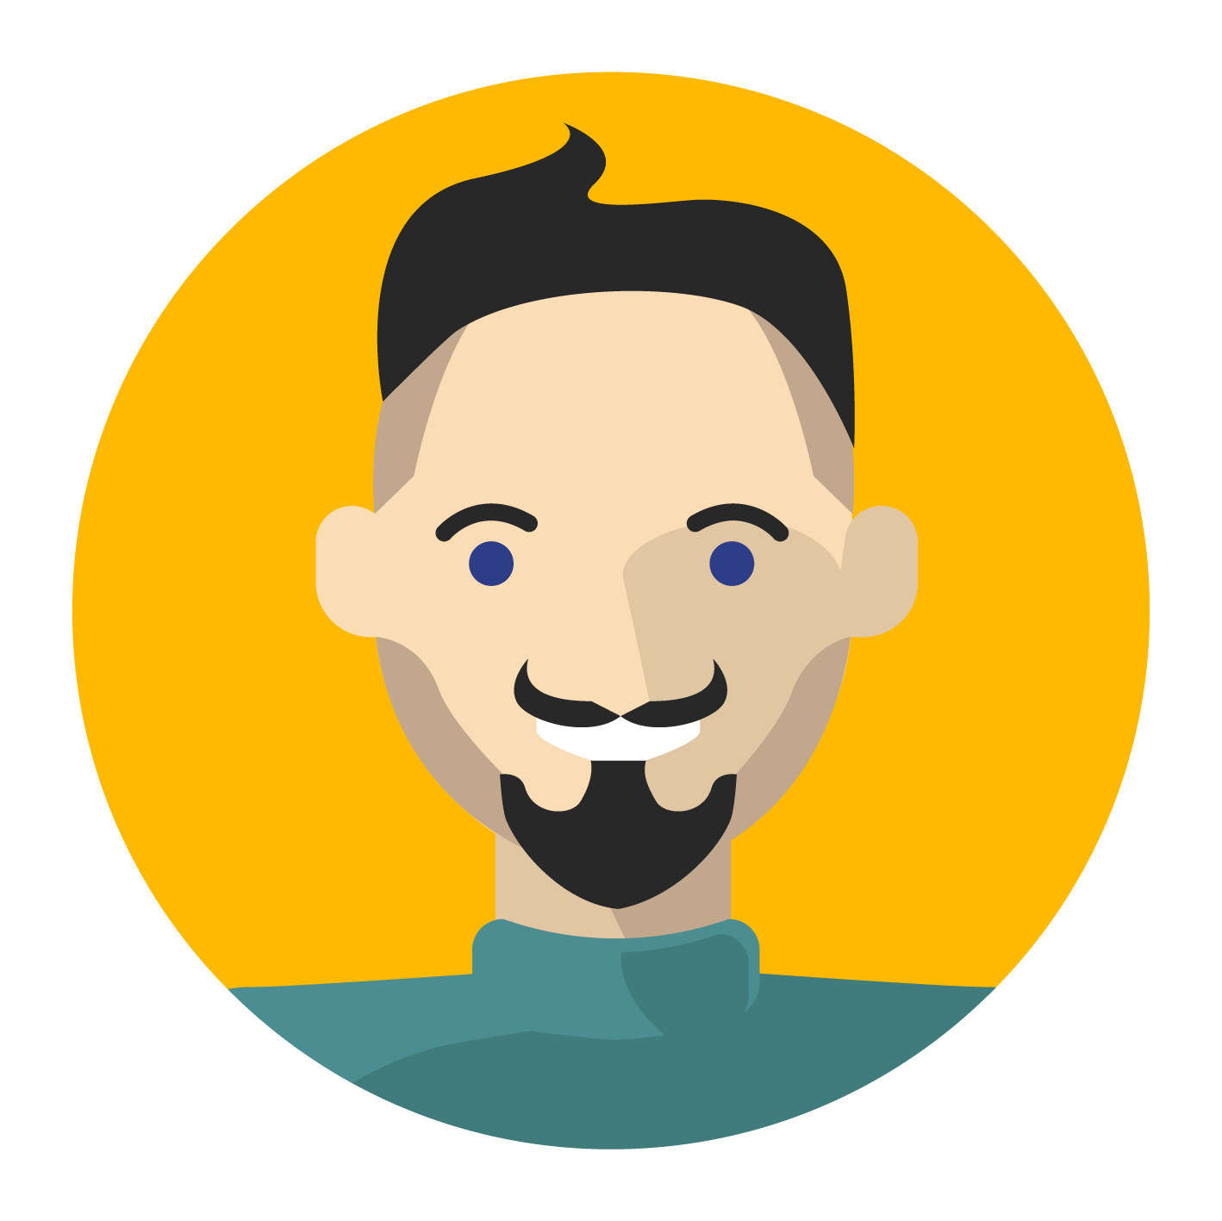
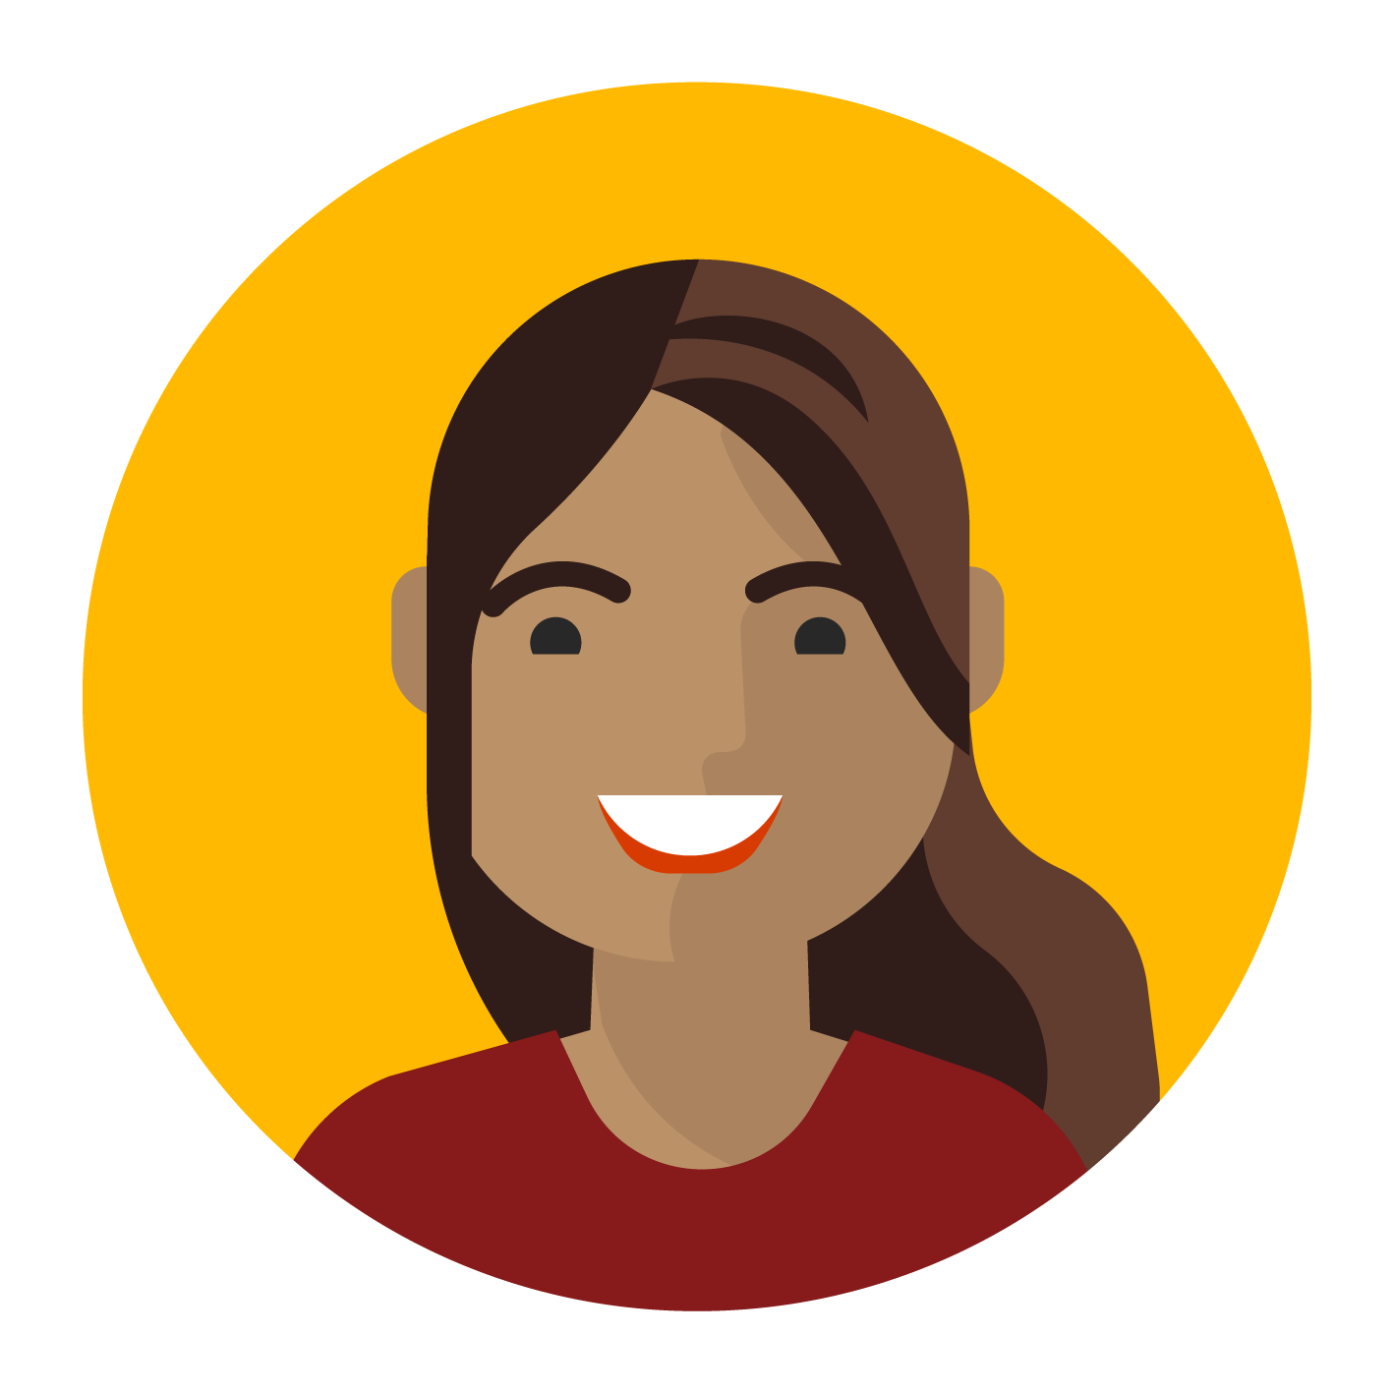

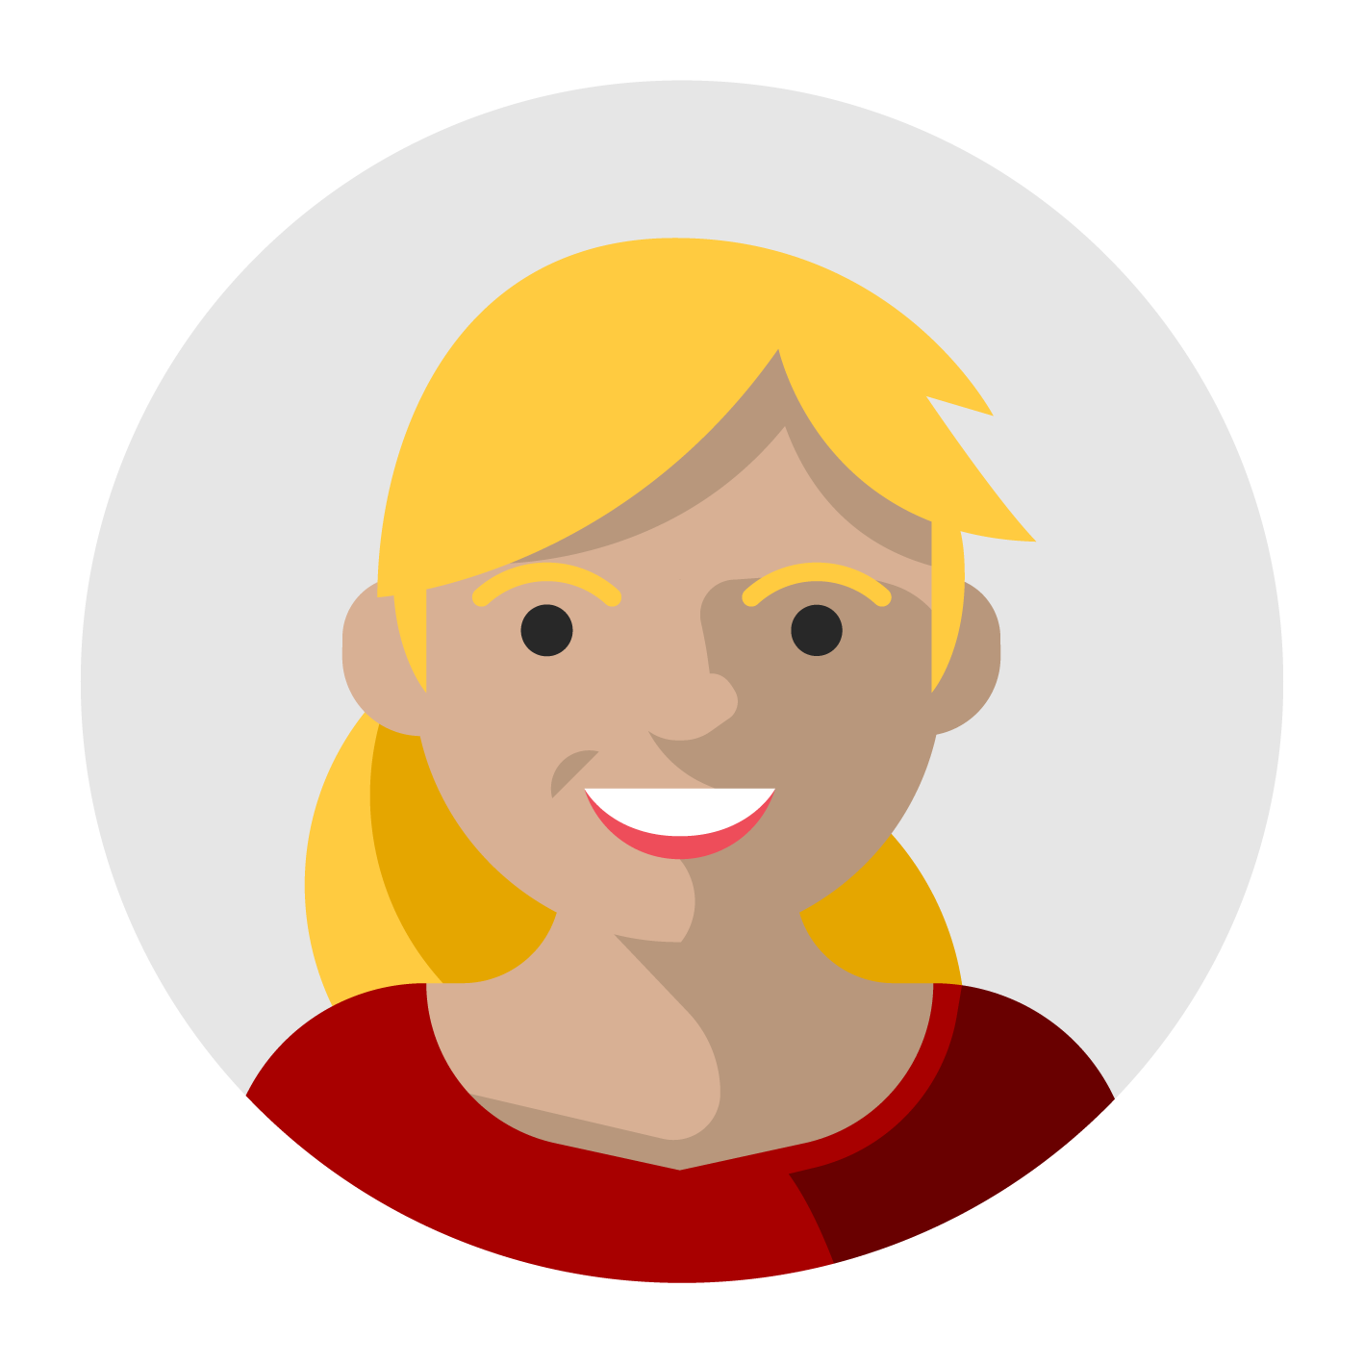

#MSTechCommunityAPACOnline
Tech Sharing
5 things you need to know about
AI/ML Singapore Community
By Sakthis Kumar, Azure MVP, Technical Director, Qonsult Systems

Slide 2
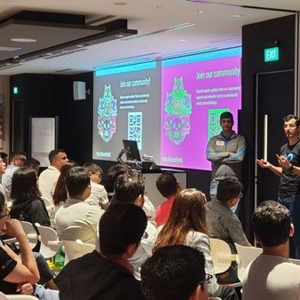
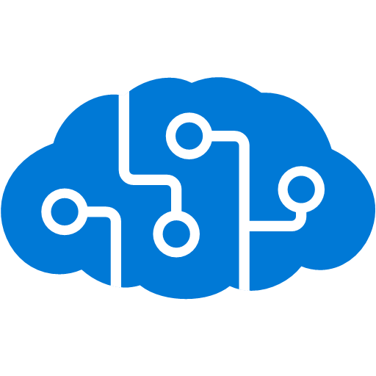
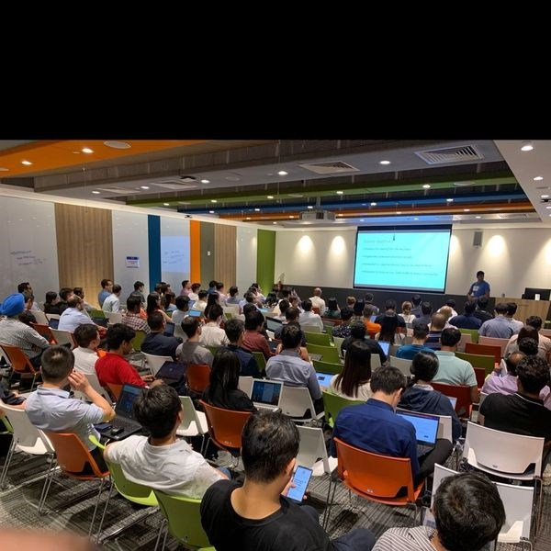
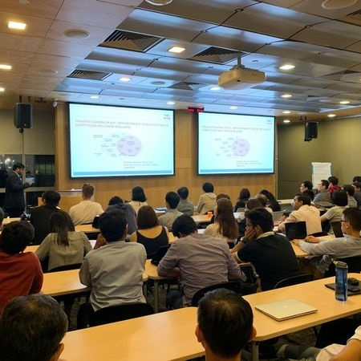
Most Hands-on Sessions, Multiple full day sessions – No BS; Only AI
Computer vision: 6 X 2 hours session
NLP: 4x 2-hour sessions
Bots: 2x 2-hour sessions (on-going)
Kaggle grandmasters / masters
Best practice sessions, up-to-date on the Microsoft offerings

Slide 3
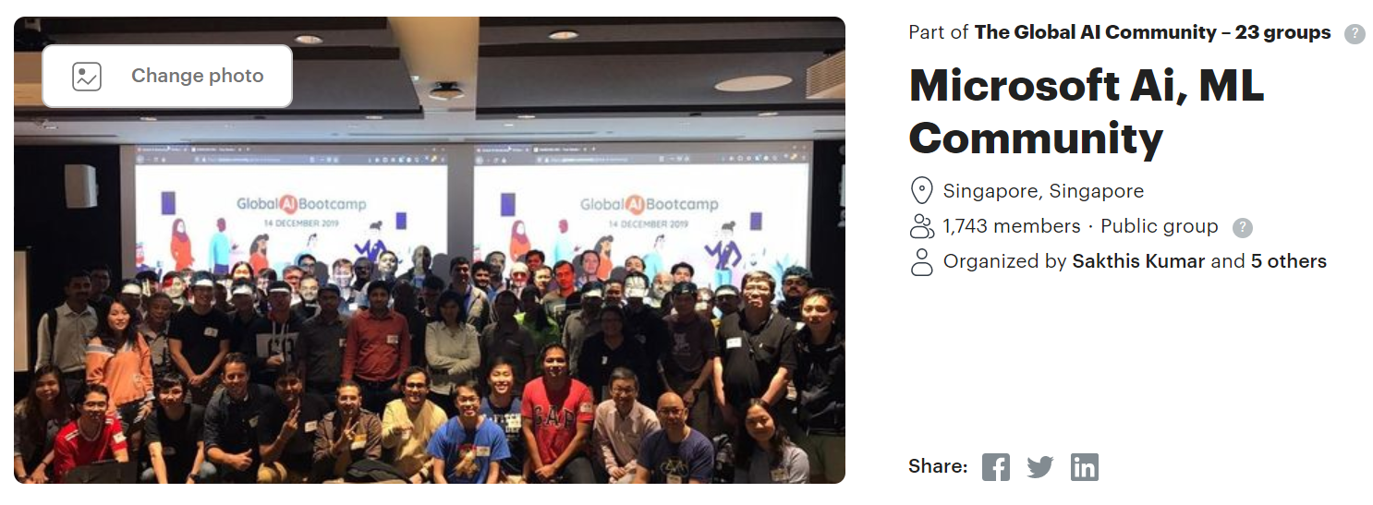
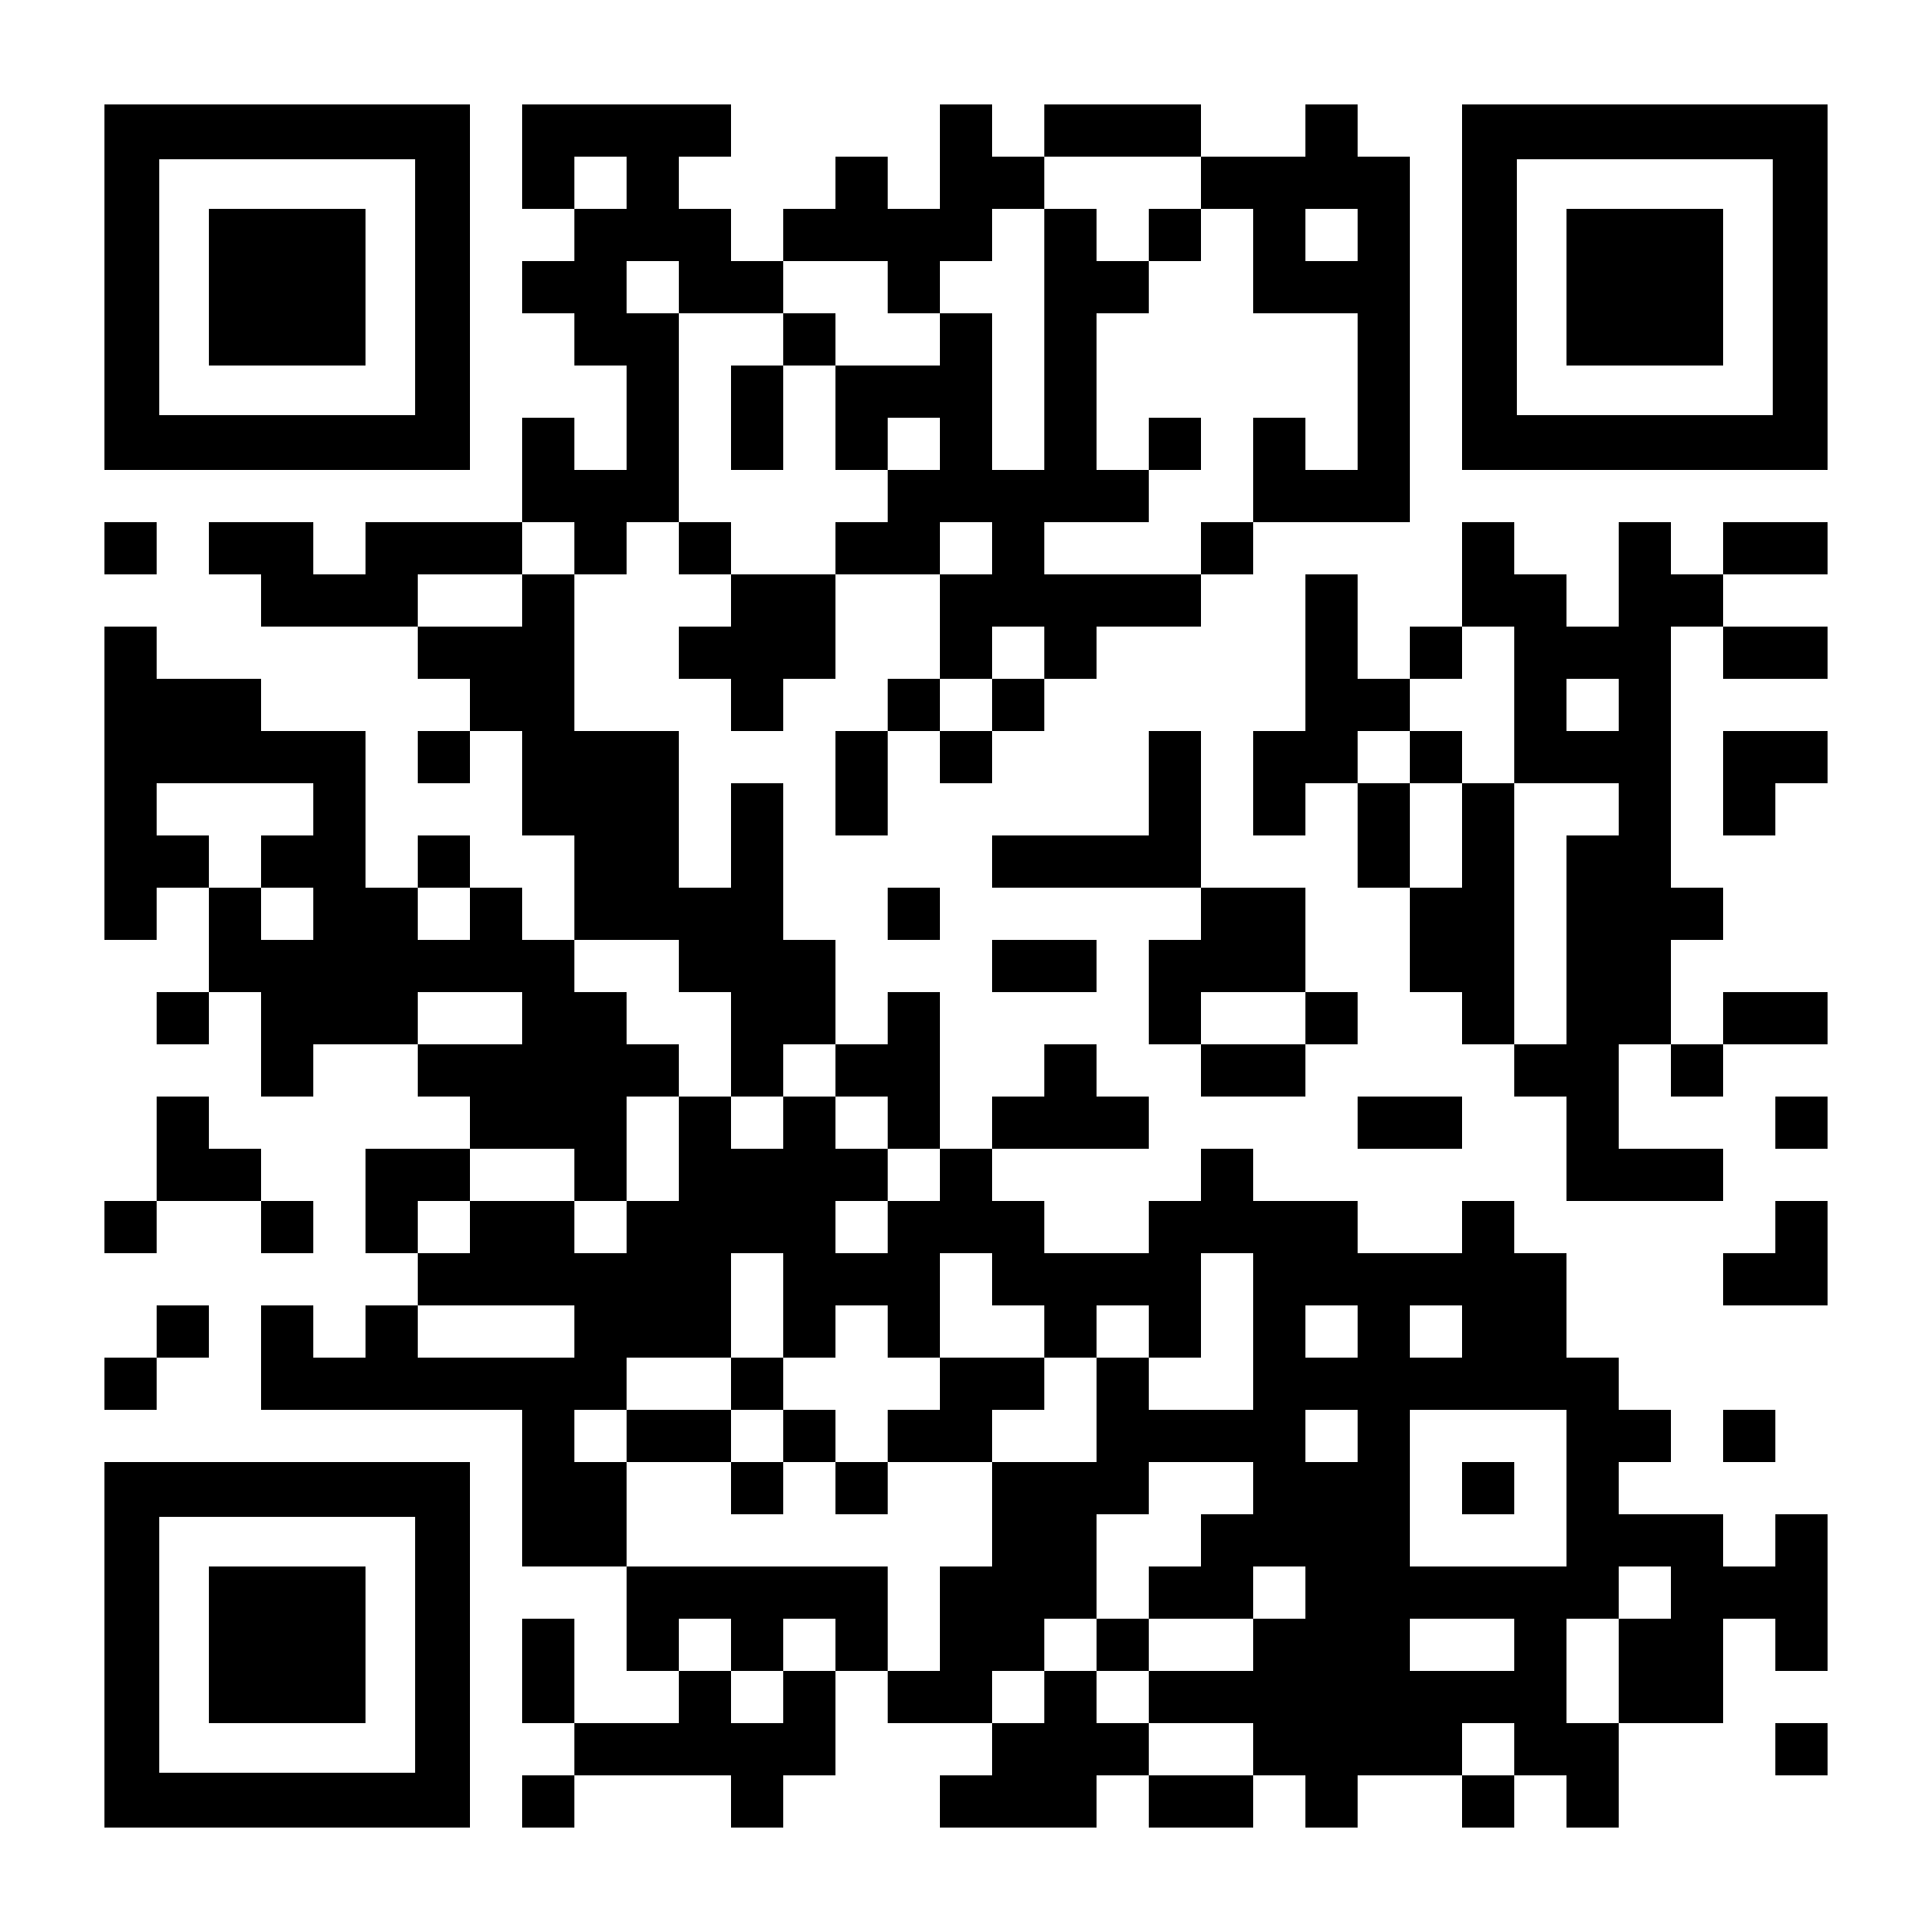

Join the community
http://bit.ly/SGMSAiML

